Slide 1

APPLY AT EASE
CO-FOUNDERS : Venkatesh Velagapudi
Sowmya Potla
Nikhil Reddy Baireddy
Sahiti Uppu
Ram Dixit Erra

Slide 2

Target Market and Value Propositions
Student’s applications
Potential employee candidature
Stakeholders
Benefiting Stakeholders and Candidates seeking job with the background check and Students with career suggestions.

Slide 3

Key Winning Features & Capabilities:
The major break-through feature is proposing courses and suggesting respective career opportunities depending on current market to students which is not available in the existing platforms.
Taking up the background check after candidate gets selected in the interview procedure, helps both stakeholders and applicants.

Slide 4

Justification
By implementing background verification, we are trying to bring a cost-effective approach as that avoids a repetitive procedure. This helps to save pockets of Stakeholders.
Developing a single platform for predicting and receiving job market recommendations based on a student's preferred set of courses and educational institutions.

Slide 5
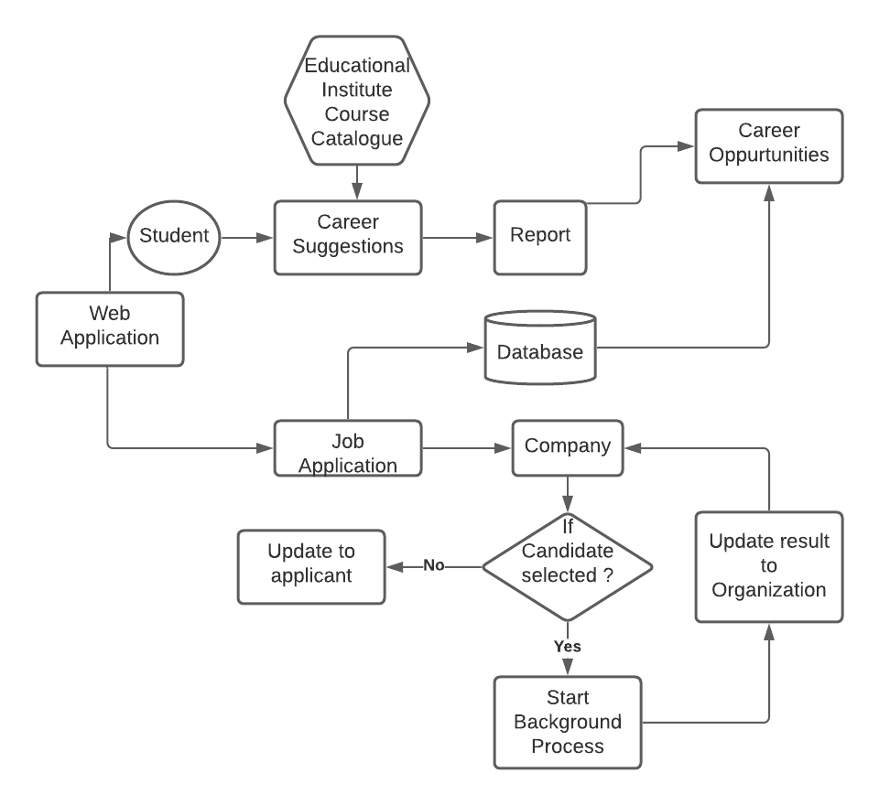
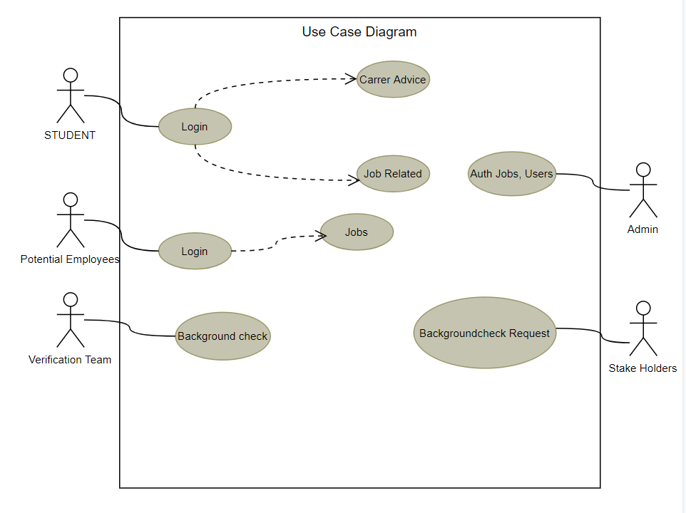
PLAN FOR IMPLEMENTATION PHASE

Slide 6

Thank You!
Conclusion
Interactive and easy to understand
Value
State
Position
Growth applications
Condition of company

